Slide 1
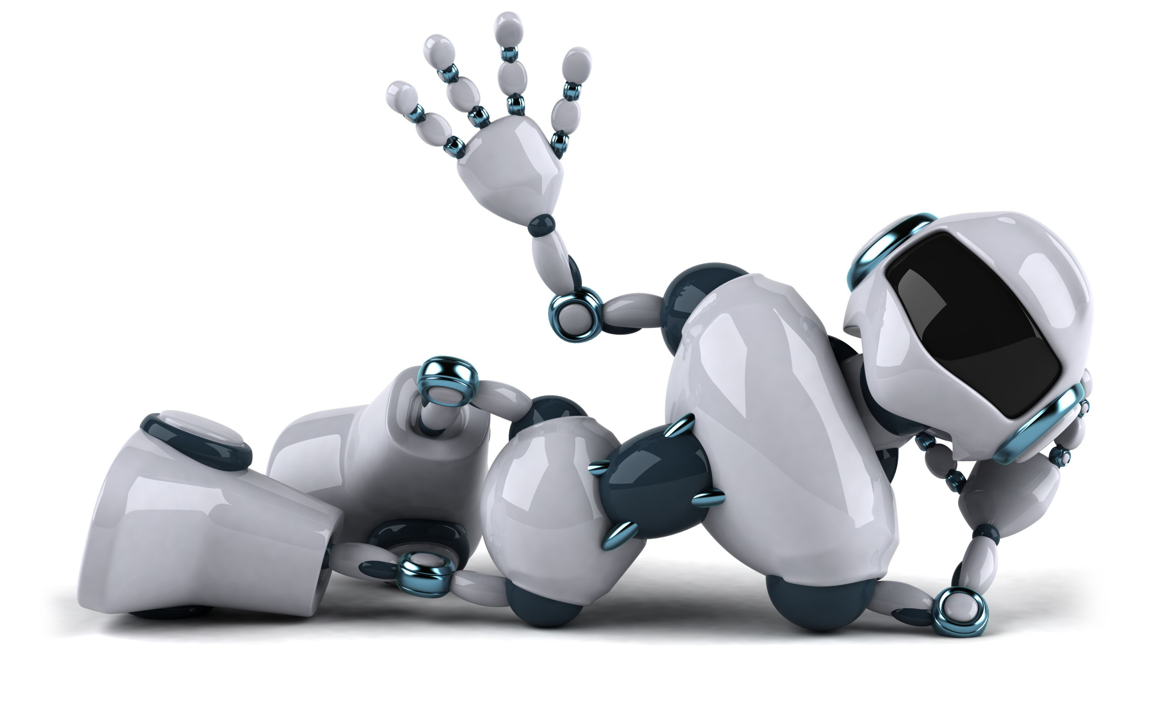
Towards a Robust Interactive and Learning Social Robot
Adrian Raszkiewicz, Pranav Parmar
04/12/2018

Slide 2

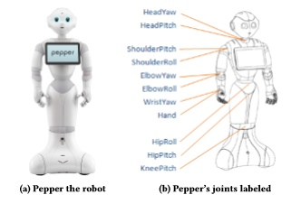
Introduction
Meet Pepper - The social robot specifically designed for social interaction
The features:
Harnessed human senses (speech, vision, gesture, input)
Multi-modal approach to increase robustness
“Robotics offers the potential for something more – something interactive, responsive, multisensory, personal.”
Developed by Aldebran Robotics based in Japan

Slide 3
Vision
Pepper will be faced with processing and analysing visual inputs.
State of art human pose and object detectors which can provide a more reliable source of information through a broader range of vision stimuli.

Slide 4
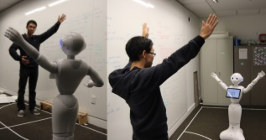
Vision: Human Recognition
Inbuilt ‘NAOqi’ operating system (by Aldebaran) contains algorithms for human-related vision tasks.
These include: Human detection, tracking, face recognition and gaze detection.
Open-Pose real-time pose detection library was integrated to help with the detection of pixel for body key points for any individual.

Slide 5
Vision: Human Recognition
Three main ROS nodes that communicate with each other through the ROS operating system; master node , the others located on external servers.
1st external node processing images from Peppers front view camera
2nd external node examines body points and processes data into useful semantic information.
These nodes communicate with each other in order to determine how/what the user is communication through his body language

Slide 6
Vision: Object Recognition
Keypoint-based object detection algorithm used along with Neural Networks (You Only Look Once and R-CNN)
‘Object’ to ‘Class’ mapping approach
Median confidence is highest for the matching class labels for both of these approaches.

Slide 7
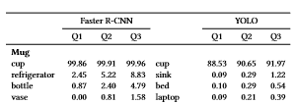

Vision: Object Recognition
Table presents the confidence scores of classifying objects for each class using both YOLO and R-CNN
Object ‘Mug’ which belongs to the COCO dataset (object categories)
Object ‘Marker’ which doesn’t belong to the COCO dataset
It was found that Pepper consistently assigns classes to objects even without the use of a COCO dataset, through proxy classes

Slide 8
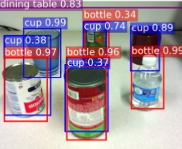
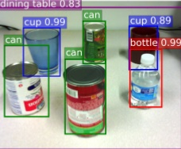
Vision: Object Recognition
Proxy class = A class label that is consistently more triggered by that particular object and not the others.
Toothbrush is a proxy class for the object Marker, Pepper identifies toothbrushes as the only object that looks alike a Marker.
Could it distinguish between the two?
In this case, an algorithm that combines the different classes can be used.
Neural networks classify the object ‘Can’ as a combination of classes ‘bottle’ and ‘cup’.

Slide 9

Speech
Pepper will be able to recognise human speech through its speech recognition
Inbuilt speech recognition
Pepper comes with an inbuilt speech recognition software. (Nauance Vocon)
Vocabulary phrases are inputted into Pepper.
We see that the recognition accuracy is lower for a larger grammar sets making it prone to errors.

Slide 10
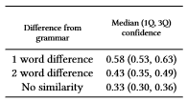
Speech
Cloud based speech recognition
Pepper also uses google cloud speech which is a streaming speech recognition software platform that utilizes a deep neural network approach that has been adapted by a multiple google users
Pepper uses multiple microphones positioned around itself.

Slide 11
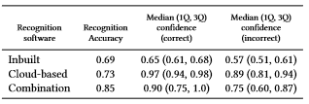
Speech – The dual approach
Speech - Parsing
The cloud based speech recognition over in-built system.
Running them both simultaneously by using separate processing modules has proven to be the most effective approach.
Input is transcribed to text
Text is broken down into parts
Matches text to a robot command using a frame semantic parser
Pepper responds based on instruction

Slide 12
Speech – Learning vocabulary
Through the use of cloud-based recognition Pepper can improve the inbuilt speech recognition system by learning new phrases encountered over time.
Adds unknown phrases to dataset for future reference
i.e. “ get me a banana from the fridge”
Pepper will add ‘banana’ to list of objects
Fridge to the list of ‘locations’
As the loading times increase linearly with the information amount
Pepper keeps track of the frequency in which it encounters different sentences and commands
Then before each session the most probable phrases will be preloaded to save loading times.

Slide 13
Mutli-Modality
Previously we described all the different features Pepper utilizes
However due to the complexity of the interaction, Pepper could potentially still struggle/fail with uncertain situations e.g. new phrases
It is vital for Pepper to be robust to these conditions.
For this reason, a number of alternate input methods have been developed.

Slide 14
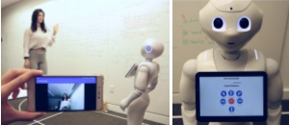
Multi-Modality: Alternative Inputs
Tablet: built-in tablet that accepts touch inputs from users when speech or vision inputs are unreliable
Mobile Application: An android application was developed for the use of controlling Pepper through an interactive interface
External Microphones: In a controlled environment (i.e. supermarket), multiple microphones can be placed in different locations.
Combining inbuilt speech, cloud based speech and external microphones improves recognition accuracy

Slide 15
Multi-Modality: Failure Tolerant Selection
If one of the previously mentioned modality fails, Pepper can still use the alternative input methods.
So how are failures measured?
Speech: If cloud-based speech recognition is considered unreliable, only the inbuilt library will be used, if that also fails pepper will redirect the user to the tablet
Vision: Confidence levels of detected objects, if low ask for more details about the object.

Slide 16
Evaluation: Pros and Cons of Pepper
&
Pros
Cons
Techniques used to extend Pepper’s capabilities could be applied to any robot development
Multi modality approach to increase accuracy
Speech recognition could still erroneously match a phrase to the wrong meaning
Vocabulary of phrases has to be reloaded every time a user launches a recognition script
Cannot recognize speech that it hasn’t been preloaded with – social interaction?

Slide 17
What we learnt
Robots can be used in various situations and can benefit many people
Robots can learn and apply new knowledge
Multi modality is important for robotics
The way the algorithms and neural networks work together to add functionality to the robot

Slide 18
Critical analysis
Struture of paper
Abstract
Introduction
Related work
Vision
Speech
Multi-modality
Conclusion
Validaity of Paper
Uses a broad range off learning approaches
Uses well known algorithms and neural networks
A large set of referenced was presented at the end of the paper, mostly from reliable sources.
Pictures and diagrams to show what they were doing, not only explain.
Future work
Connecting ‘Peppers’ around the world to share data
Can be applied to any robot
Pepper can be deployed in real world scenarios.

Slide 19
Conclusion
State of art vision, State of art speech and algorithms to improve communication over time.
Multi-modality considering the limitations
It is not strictly bound to just Pepper, can be applied to multiple robotic systems
The system built in this project is very robust that can be applied in multiple situations
The critical thinking is vital for robotic development
Overall project is still in its developing stage, a lot of different features could still be improved and added

Slide 20
Questions?

